Slide 1

Mesoor
[ AI-driven Human Resource ]

Slide 2


Mesoor profile
AIHR
Big data
Screen resume

Slide 3

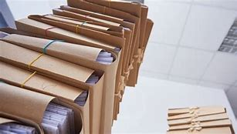


collect
classify
Scene play
1
Messy to collate
2
Error-prone
3
analyze
compare
Hard to compare
4
Low efficency

Slide 4

此处添加标题
Add the title here
Resume processor
1.
Establishing talent pool
2.
recognize automatically
3.
Compare
4.
Robot interview

Slide 5


Pandemic influence
No influence

Slide 6



Support of government

Slide 7
Role on economy
Entreprenuerial company
Connector
01
02
Full of vigor
B 2 B

Slide 8
THANK YOU

